Slide 1
Bioenergetics
INTER 111: Graduate Biochemistry

Slide 2
Bioenergetics: Learning objectives
The change in free energy for a reaction predicts the direction in which it will spontaneously proceed.
What do positive, negative, and zero values for ΔG signify for a chemical reaction?
You should know the relationship of ΔG between the forward and back reactions and understand the coupling of standard free energy changes (ΔGº) for multiple reactions.
There is a thermodynamic relationship between free energy, enthalpy, and entropy.

Slide 3
Bioenergetics
Studies how energy is utilized and transferred in cells.
Is concerned with energy involved in making/breaking of molecular bonds within biological organisms.
includes the study of different cellular processes (cellular respiration, metabolism, growth, and development) that lead to production and utilization of energy in forms such as ATP molecules.

Slide 4
Bioenergetics
It is primarily concerned with the initial and final energy states of a chemical reaction.
The change in free energy between the initial and final states of a reaction allows prediction if the reaction is possible.
A B

Slide 5
Relationship between changes in free energy, enthalpy, and entropy
Heat released or absorbed during a reaction
enthalpy change
ΔG = ΔH – TΔS
ΔG
ΔH
ΔS
entropy change
Measure of randomness
free energy
change
Energy available to do work

Slide 6
Changes in free energy of a reaction are defined in two different forms
A B
A B
ΔG_{rxn}
= G_{product} – G_{reactant}
ΔG
For any specified [A] and [B]
ΔGº
Standard free energy change
[A] = 1 M, [B] = 1 M, pH = 7

Slide 7
A negative ΔG indicates the reaction is spontaneous as written
A B
ΔG_{forward rxn}
= G_{product} – G_{reactant}
= G_{B} – G_{A}

Slide 8
A positive ΔG indicates the reaction is not spontaneous as written
ΔG_{back rxn}
= G_{product} – G_{reactant}
= G_{A} – G_{B}
A B

Slide 9
The magnitude of ΔG for the forward and back reactions is equivalent
ΔG_{forward rxn} = - ΔG_{back} _{rxn}
A B

Slide 10
At constant temperature and pressure, ΔG and ΔGº are related.
glucose
6-phosphate
fructose
6-phosphate
[B]
[A]
ΔG = ΔGº + RT ln
A B
A B

Slide 11
ΔGº is predictive only standard conditions
[B]
[A]
ΔG = ΔGº + RT ln
glucose
6-phosphate
fructose
6-phosphate
A B
A B
ΔGº = standard free energy change
ΔG = ΔGº
A
= 1 M
standard
conditions
B
= 1 M

Slide 12
ΔG depends on the concentration of reactants and products
[B]
[A]
ΔG = ΔGº + RT ln
glucose
6-phosphate
fructose
6-phosphate
A B
A B
Can the reaction proceed in the forward direction, i.e. produce fructose 6-phosphate?
ΔG = ΔGº = + 0.4 kcal/mol
A
= 0.90 M
nonequilibrium
conditions
B
= 0.09 M

Slide 13
ΔG of a reaction is zero at equilibrium
A B
A B
nonequilibrium
conditions
standard
conditions
equilibrium
conditions
ΔG = - 0.96 kcal/mol
ΔG = ΔGº = + 0.4 kcal/mol
ΔG = 0 kcal/mol
A
= 0.90 M
A
= 1 M
A
= 0.66 M
B
= 0.09 M
B
= 1 M
B
= 0.33 M

Slide 14
ΔG of a reaction is zero at equilibrium
A B
A B
equilibrium
conditions
[B]_{eq}
[A]_{eq}
= K_{eq} = equilibrium constant
ΔG = 0 kcal/mol
A
= 0.66 M
ΔGº = - RT ln K_{eq}
B
= 0.33 M

Slide 15
ΔGº values of two consecutive reactions are additive
ATP +
glucose
ADP +
glucose
6-phosphate
G A
ΔGº = −4.0 kcal/mol
glucose
6-phosphate
A B
fructose
6-phosphate
ΔGº = +0.4 kcal/mol
glucose
G B
fructose
6-phosphate
ΔGº = −3.6 kcal/mol

Slide 16
ΔG values of consecutive reactions are also additive
Additive property of free energy changes is central to biochemical pathways.
If sum of individual reaction ΔGs is negative, pathway can proceed as written.

Slide 17
Coupling an energetically favorable process with and an unfavorable one

Slide 18
Reactions are coupled through a common intermediate
A +
B C
D
+ D
D
D +
X Y
+ Z

Slide 19
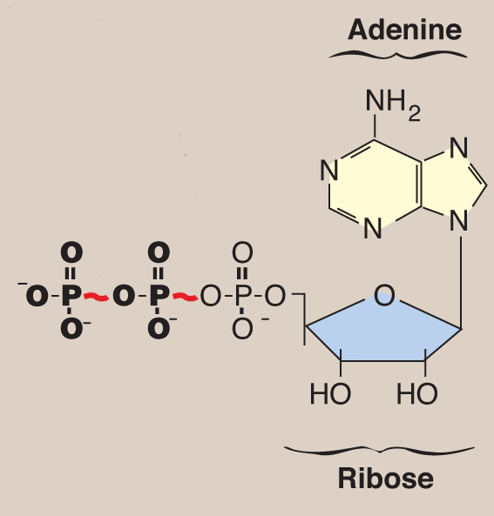
Exergonic hydrolysis of ATP is often coupled to endergonic processes
ATP ADP + P_{i}
γ
β
α
ATP AMP + PP_{i}

